Slide 1
E-Mail Spam Filtering using Machine Learning and NLTK
GUIDE :- VIJENDRA SINGH BRAHME

Slide 2
TEAM MEMBERS:-
PARV KHANDELWAL – 23BCE11
SAMARTH KADAM – 23BCE11323
PRANAV DUBEY – 23BCE11621
UDIT GUPTA – 23BCE11
NAMAN DHAKAD – 23BCE

Slide 3
INTRODUCTION
Problem:
E-MAIL spam impacts users by wasting resources and leading to scams or phishing attacks.
Goal:
To create a machine learning-based spam detection system.
Process SMS data efficiently and classify messages as spam or non-spam.
Key Features:
Text preprocessing using NLTK.
Multiple machine learning models evaluated for performance.

Slide 4
EXISTING WORK WITH LIMITATION
Existing Work with Limitations
Existing Approaches:
Rule-based filtering (e.g., keyword-based systems).
Basic supervised models.
Limitations:
Require extensive labeled datasets.
Ineffective against new spam techniques.
High false positives and poor generalization.

Slide 5
PROPOSED WORK AND METHODOLOGY
Proposed Work:
Use a combination of text preprocessing techniques and machine learning models.
Implement ensemble methods for better accuracy.
Methodology:
Data Preprocessing:
Regex-based cleaning, stopword removal, stemming.
Feature Extraction:
Bag of Words (BoW) with the top 1500 frequent words.
Model Training:
Use classifiers like SVM, Naive Bayes, and VotingClassifier.
Evaluation:
Accuracy, precision, recall, and F1-score.

Slide 6
NOVELTY OF THE PROJECT
Novel Aspects:
Combines multiple machine learning classifiers in an ensemble model.
Implements thorough text cleaning and preprocessing for feature creation.
Evaluates model effectiveness through comparative analysis.

Slide 7
Real-Time Usage
Applications:
Integrate with SMS services to filter spam messages in real-time.
Mobile network operators can block spam messages proactively.
Prevent phishing attacks and scams through automated detection.

Slide 8
Hardware & Software Requirements
Hardware:
Minimum: 4GB RAM, i5 Processor.
Software:
Python 3.12
Libraries: NLTK, Scikit-learn, Pandas, NumPy
IDE: Visual Studio Code or Google Colab.

Slide 9
Literature Review
Discuss:
NLTK: For text preprocessing and feature extraction.
Scikit-learn: For implementing classifiers and evaluation metrics.
Classifiers used:
Naive Bayes: Fast and simple probabilistic classifier.
SVM: Effective for binary classification.
Ensemble methods: Combine multiple models for better accuracy.

Slide 10
MODULE DESCRIPTION
Data Preprocessing Module
The first module focuses on preparing raw SMS data for machine learning by cleaning and transforming text into a standardized format. This involves loading the dataset and performing essential preprocessing tasks.
Tokenization splits the text into individual words, which are further filtered by removing stopwords (common words like “is” or “the” that add little value to classification). Finally, stemming is applied using the Porter Stemmer to reduce words to their root form, such as converting “running” and “runner” to “run.”
Feature Extraction Module
The second module transforms the preprocessed text into numerical representations that can be used by machine learning algorithms. This is achieved using the Bag of Words (BoW) model, where the most frequent 1500 words in the dataset are identified as features.

Slide 11
MODULE DESCRIPTION
Classification Module
The classification module trains machine learning models to differentiate between spam and non-spam messages. The dataset is split into training and testing sets, typically with 75% of the data used for training and 25% reserved for testing.
Various classifiers are trained, including Naive Bayes, Support Vector Machines (SVM), Logistic Regression, Random Forest, Decision Trees, and K-Nearest Neighbors (KNN).

Slide 12
MODULE DESCRIPTION
Ensemble Evaluation Module
This module evaluates the performance of individual classifiers and the ensemble model. Metrics such as accuracy, precision, recall, and F1-score are calculated for each model. A confusion matrix is generated for the ensemble classifier, showing the true positives (spam correctly classified as spam), true negatives (non-spam correctly classified as non-spam), false positives (non-spam incorrectly classified as spam), and false negatives (spam incorrectly classified as non-spam).
Testing Module
The testing module validates the system's ability to classify unseen messages. Real-world examples of SMS messages, such as “Congratulations! You’ve won $1,000. Claim now” (spam) or “Are we still meeting at 5 PM?” (non-spam), are used for this purpose. These new messages undergo the same preprocessing and feature extraction steps as the training data.

Slide 13
MODULE DESCRIPTION
Visualization and Reporting Module
The final module provides a visual and analytical summary of the system's performance. A confusion matrix is presented as a table, highlighting classification results for the testing set. Accuracy comparisons between individual classifiers and the ensemble method are shown using bar graphs.

Slide 14
SUMMARY TABLE
Module | Key Features | Output
Data Preprocessing | Text cleaning, tokenization, stopword removal, stemming | Cleaned text data
Feature Extraction | Bag of Words, feature vectors for top 1500 words | Feature vectors and labels
Classification | Training multiple classifiers (SVM, Naive Bayes, Logistic Regression, etc.) | Trained classifiers
Ensemble Evaluation | Combine predictions using VotingClassifier, calculate metrics | Performance metrics (accuracy, precision, recall)
Testing | Real-time predictions for new SMS messages | Spam/Non-spam classification results
Visualization and Reporting | Confusion matrix, accuracy comparison, word frequency visualization | Graphical insights into performance

Slide 15
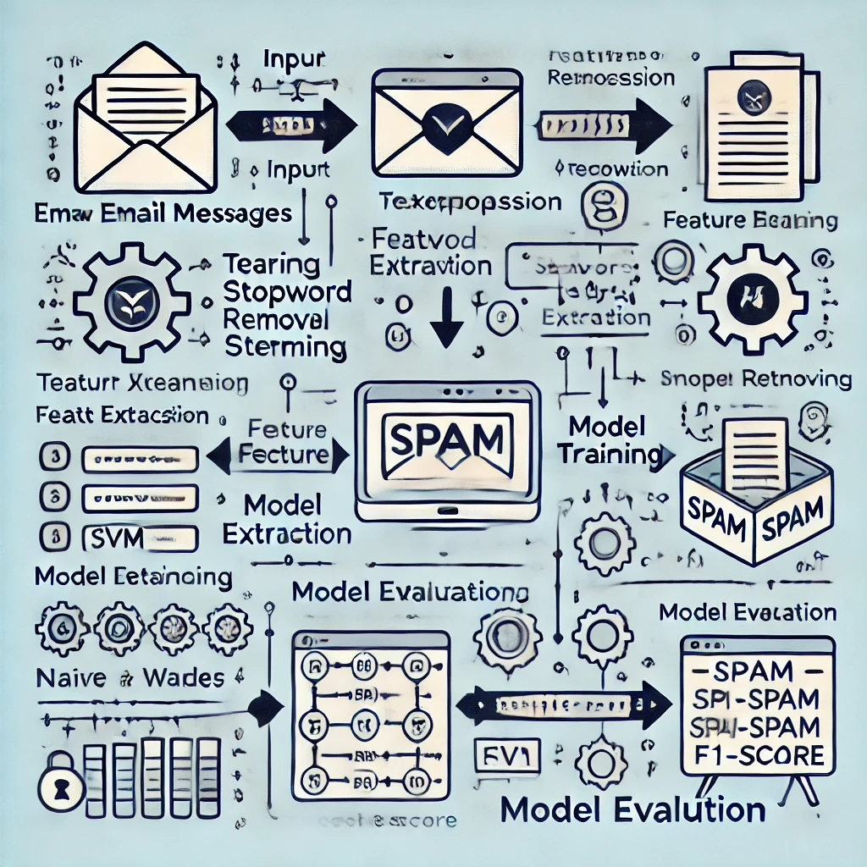
MODULE WORKFLOW EXPLAINATION

Slide 16
Implementation and Coding
Key Highlights from Your Script:
Preprocessing:
Replace emails, URLs, phone numbers, and symbols with placeholders.
Apply stemming with the Porter Stemmer.
Feature Extraction:
Use the top 1500 words as features.
Classifiers:
Train and evaluate multiple models (SVM, Naive Bayes, Logistic Regression, etc.).
Implement ensemble methods using the Voting Classifier.

Slide 17
DEMO VIDEO

Slide 18
SNAPSHOT OF PROJECT

Slide 19
Testing
Details:
Dataset split: 75% training, 25% testing.
Metrics used for evaluation: Accuracy, precision, recall, F1-score.
Show confusion matrix results.

Slide 20
Result and Discussion
Results:
Best accuracy achieved: [Mention percentage].
Precision, recall, and F1-scores for spam detection.
Discussion:
SVM and ensemble methods outperformed others.
Limitations in handling ambiguous messages.

Slide 21
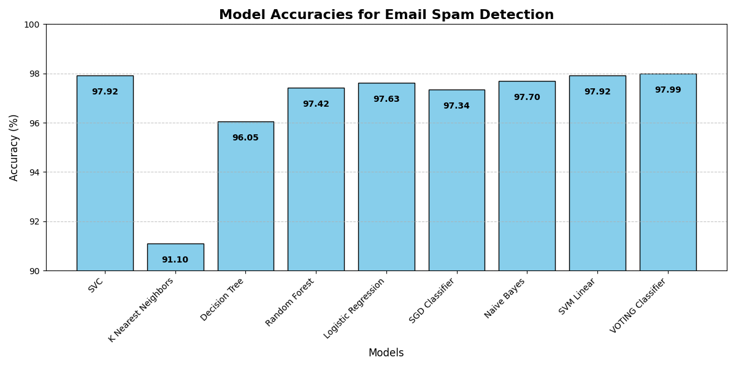
GRAPH FOR MMODEL ACCURACIES

Slide 22
Conclusion
Summary:
The system effectively classifies SMS as spam or non-spam.
Ensemble methods improved accuracy over individual classifiers.
Future Work:
Extend the model to multilingual datasets.
Incorporate deep learning models like LSTMs for improved context handling.

